Slide 1
MACHINE LEARNING FOR 5G FUTURE

Slide 2
Objectives
What is Machine Learning?
Why is it important?
What is 5G?
How do we use machine learning in 5G planning and deployment?
How Machine Learning influences in 5G future?

Slide 3
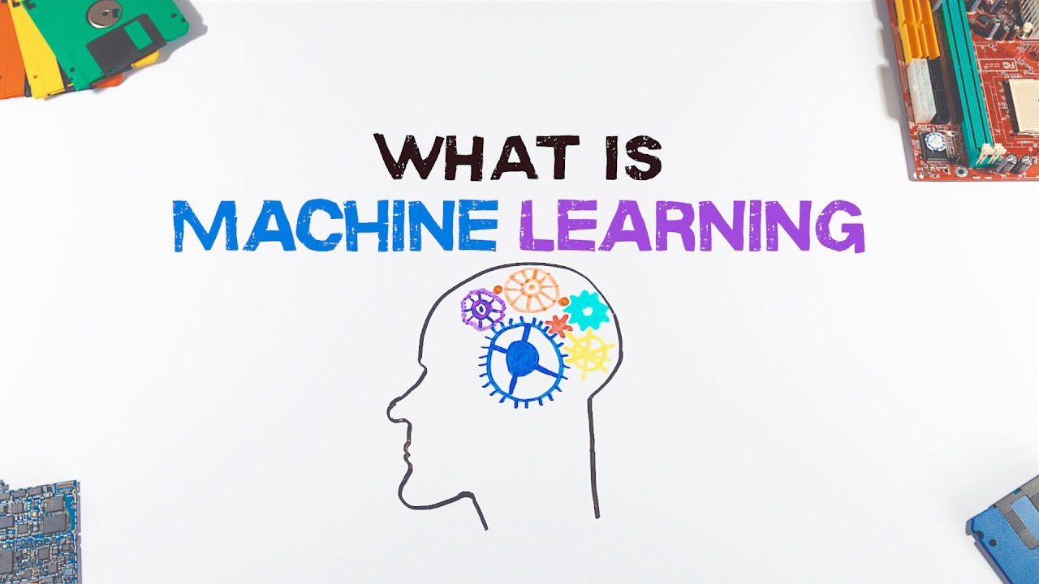

Slide 4
Machine learning is an application of artificial intelligence (AI) that provides systems the ability to automatically learn and improve from experience without being explicitly programmed. Machine learning focuses on the development of computer programs that can access data and use it to learn for themselves.
Machine learning (ML) is the study of computer algorithms that improve automatically through experience. It is seen as a subset of artificial intelligence. Machine learning algorithms build a mathematical model based on sample data, known as "training data", in order to make predictions or decisions without being explicitly programmed to do so.

Slide 5
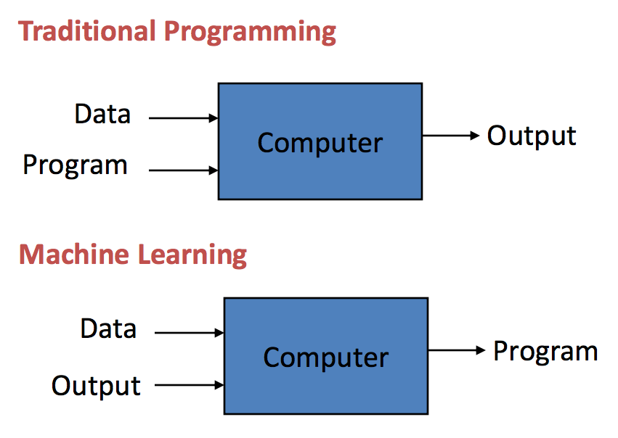

Slide 6
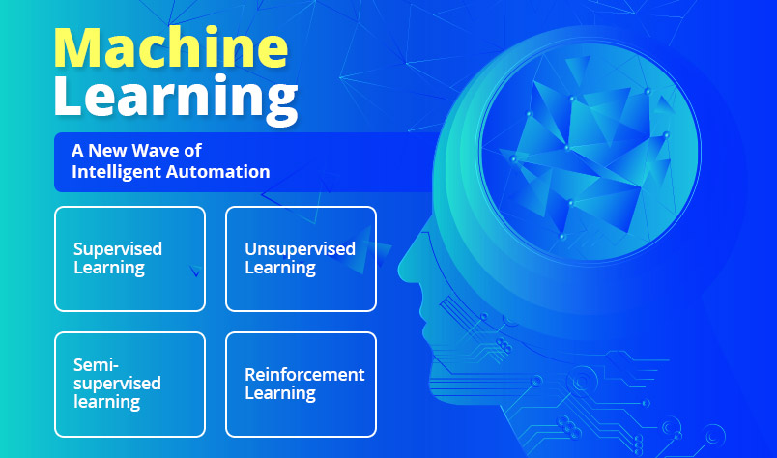
Machine learning approaches are traditionally divided into these broad categories:

Slide 7
1.Supervised learning: The computer is presented with example inputs and their desired outputs, given by a "teacher", and the goal is to learn a general rule that maps inputs to outputs.
2.Unsupervised learning: No labels are given to the learning algorithm, leaving it on its own to find structure in its input. Unsupervised learning can be a goal in itself or a means towards an end.
3.Reinforcement learning: A computer program interacts with a dynamic environment in which it must perform a certain goal. As it navigates its problem space, the program is provided feedback that's analogous to rewards, which it tries to maximize.

Slide 8
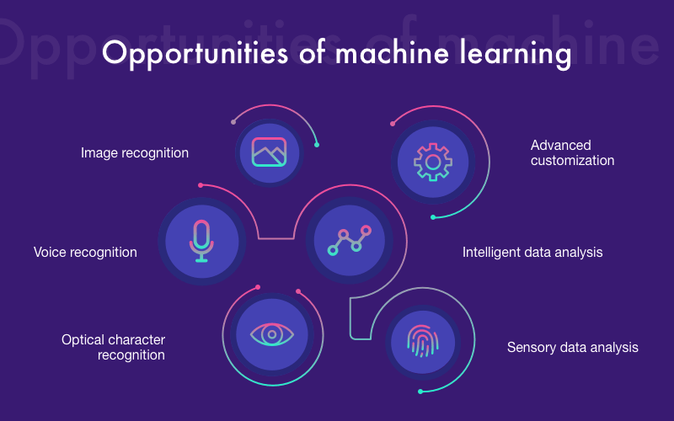
WHY IS IT IMPORTANT?

Slide 9
Main purposes of Machine Learning:
Reactive machines
Limited memory
Theory of mind

Slide 10
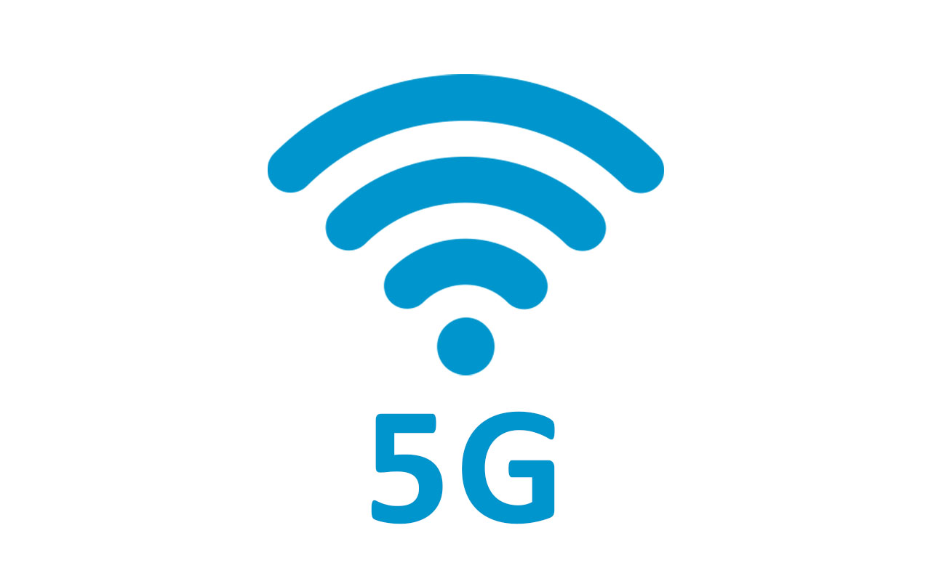

Slide 11
What is 5G?
5G is next generation wireless network technology that’s expected to change the way people live and work. It will be faster and able to handle more connected devices than the existing 4G LTE network, improvements that will enable a wave of new kinds of tech products. 5G networks began rolling out in the United States and around the world in 2018 and are still in their early days, but experts say the potential is huge.

Slide 12
Why we need 5G than 4G network ?
Much of the hype around 5G has to do with speed. But there are other perks, too. 5G will have greater bandwidth, meaning it can handle many more connected devices than previous networks. That means no more spotty service when you’re in a crowded area. And it will enable even more connected devices like smart toothbrushes and self-driving cars. 5G will also reduce latency — the time it takes for a cell phone (or other connected device) to make a request from a server and get a response — to virtually zero. And it will make communication with cloud platforms faster and easier.

Slide 13
How 5G works?
With 5G, signals run over new radio frequencies, which requires updating radios and other equipment on cell towers. There are three different methods for building a 5G network, depending on the type of assets a wireless carrier has: low-band network (wide coverage area but only about 20% faster than 4G), high-band network (superfast speeds but signals don’t travel well and struggle to move through hard surfaces) and mid-band network (balances speed and coverage).

Slide 14
How do we use machine learning in 5G planning and deployment?
5G is a change of concept in mobile services; this new concept will assume new frequencies to provide different kinds of services routing communications based on the speed needed for the service looking to obtain the maximum performance combining coverage, propagation and the penetration bandwidth compatible with the kind of service to be used. This service will combine different techniques such as frequency allocation, carrier aggregation or MIMO (multiple in multiple out) as an example.
The knowledge obtained from 4G analysis performs the basis for the 5G model.

Slide 15
How do we use machine learning in 5G planning and deployment?
To design the new model the definition of segmented models is highly significant, where we will test the obtained predictive functions, testing the needs of coverage and based on service areas and demand of services.
Once the type of demand of service can be managed by changing the variable values, we will introduce new frequencies and services looking for the reinforcement of services in the mapped areas where the model shows there is a lack of services.

Slide 16
How do we use machine learning in 5G planning and deployment?
Network deployment using this tool will allow the measuring of the values predicted for the system and the values obtained will be used to provide feedback to the systems providing new entrances to validate the model and reinforce the learning capabilities of the system based in machine learning.
It is very important to define the scenario of where we are working, starting with the definition of the components of the system identifying the variables with incidence in the work with the functions that predict the behavior of these variables.
All these variables with an undefined standard set of values or logical status will be played using Montecarlo models, Markov chains or other statistical sources, based in the universe of the variable and its statistical patterns.

Slide 17
How do we use machine learning in 5G planning and deployment?
5G will need a great quantity of sites with different frequencies and services. This situation will create a complex and multivariable scenario.
Machine learning gives us the tools to define the patterns in this multivariable scenario, showing even those patterns for which we do not know of their existence.
The use of geographical interfaces gives us the opportunity to plot different patterns obtained from propagation calculus and contrasted by collaborative sensing provided by handhelds with software applications.

Slide 18
CONCLUSION
Machines should be able to do all the things what we can do & machine learning will play a big role in achieving this goal and we must use machines for a better and healthy world. We should not use machines that may cause harm to mankind.

